Slide 1
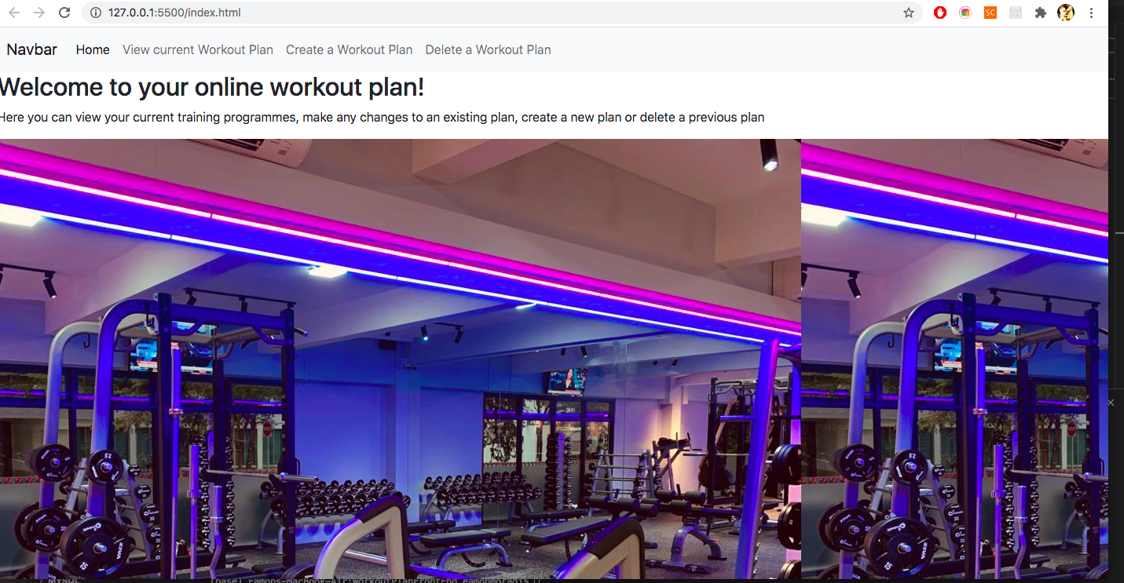
Exercise and Workout Planner

Slide 2
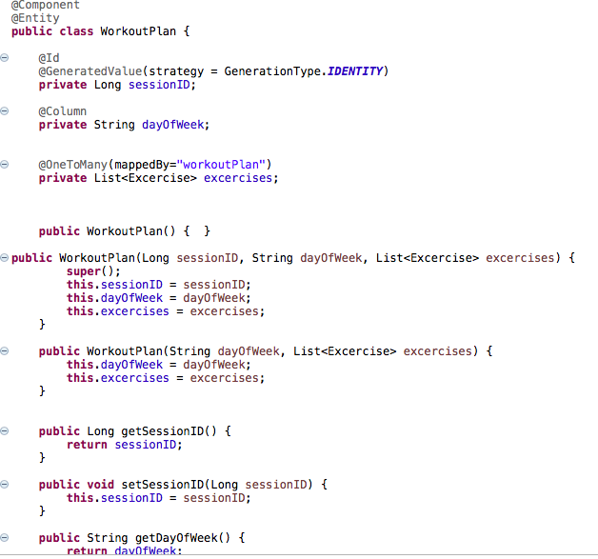
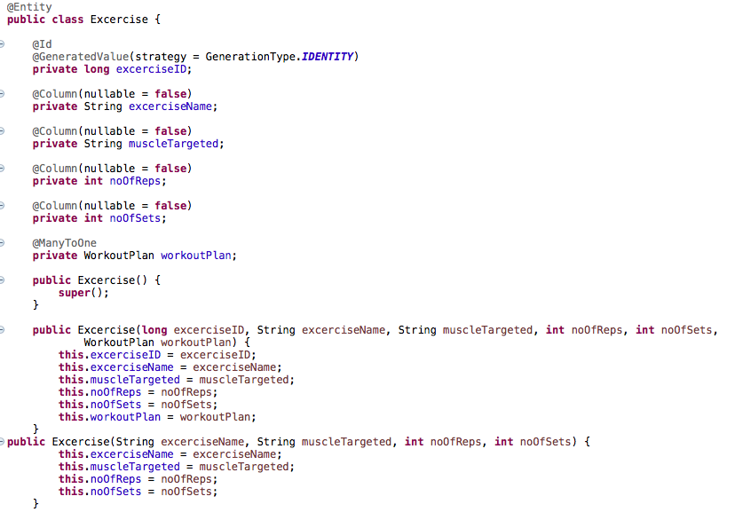
Created Entities which can be transferred to JSON when accessed in through a web application.

Slide 3
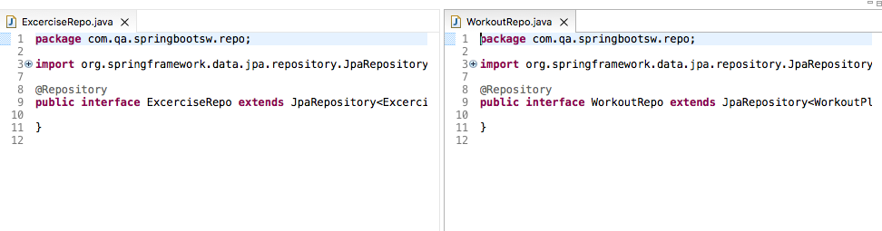
Created Repository for entities to store objects in a collection. This allows user to search and retrieve created objects in the springboot app.

Slide 4
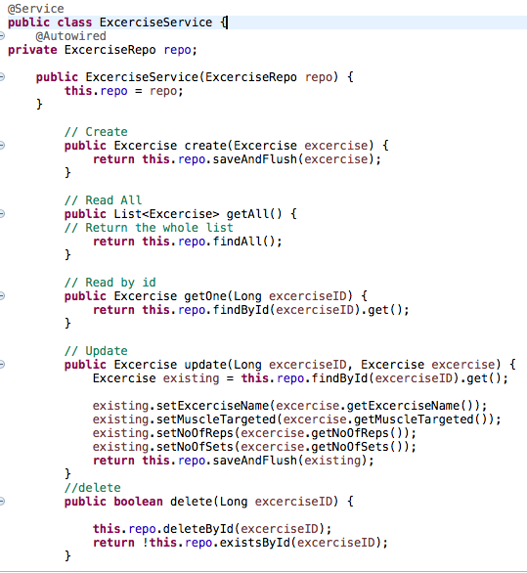
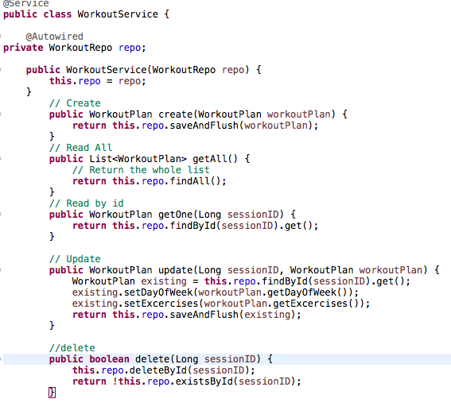
Added Service bean to handle CRUD functionality of the entities using methods which are part of the JPArepository class.

Slide 5
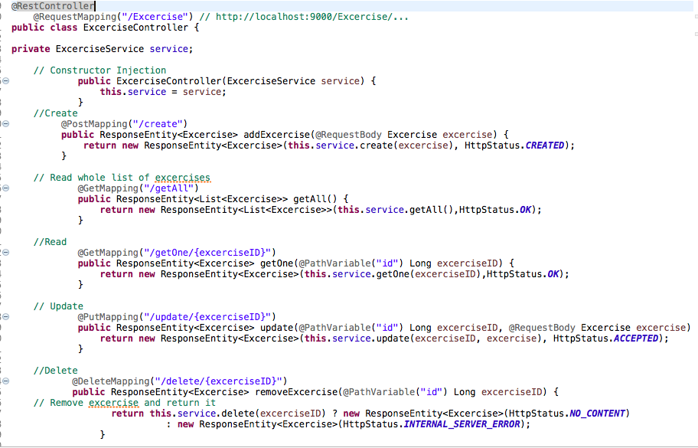
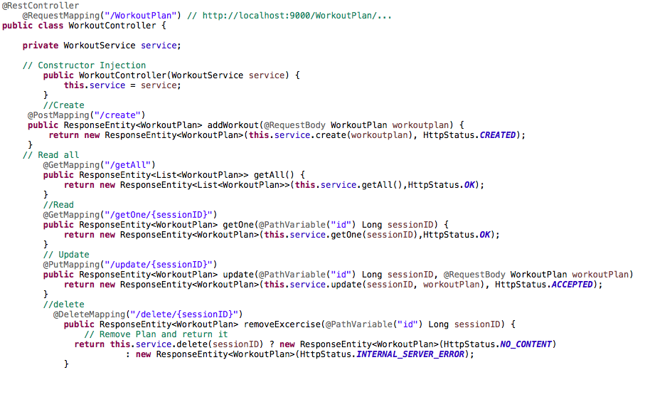
Added controller to handle requests between client and web application.

Slide 6
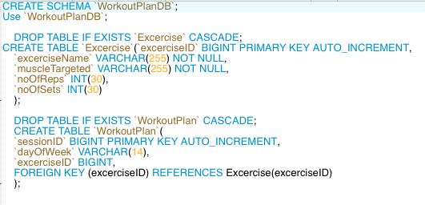
Created schema and tables using SQL, to store data in a database.

Slide 7
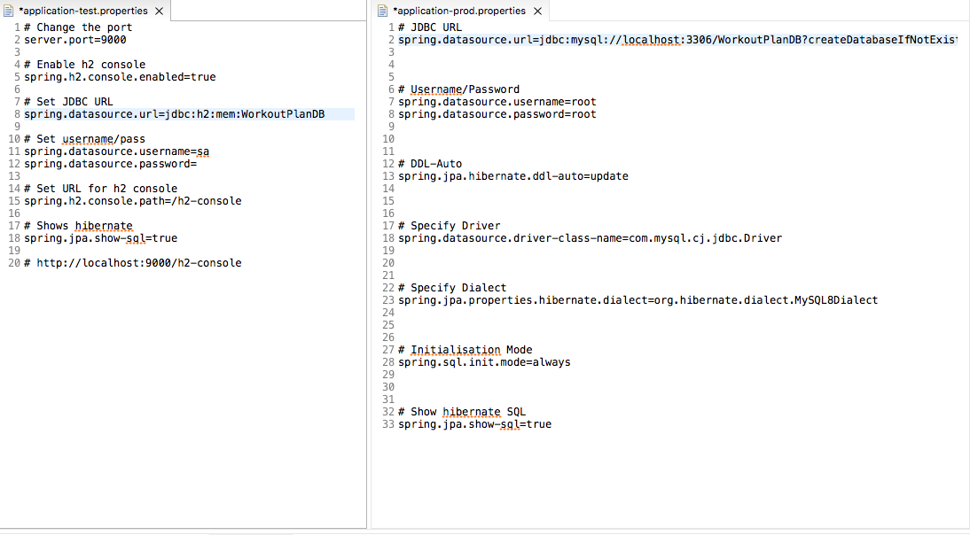
Created application property files to be able to connect to test and production instances.

Slide 8
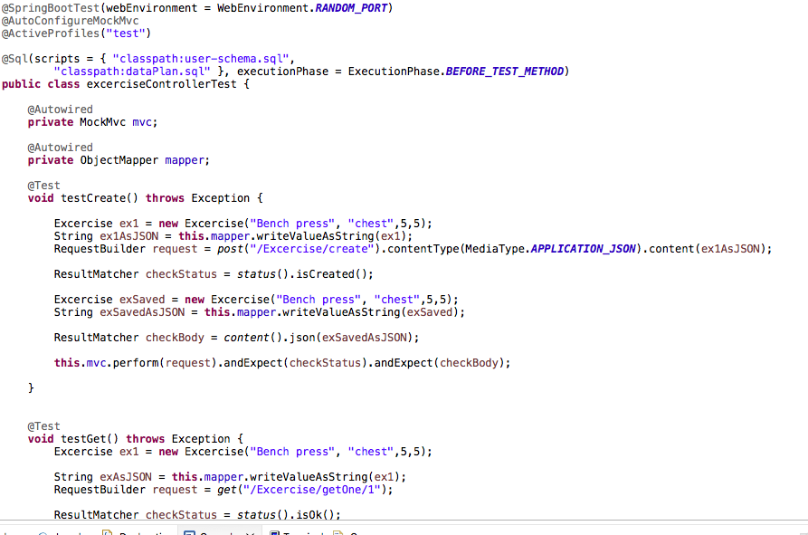
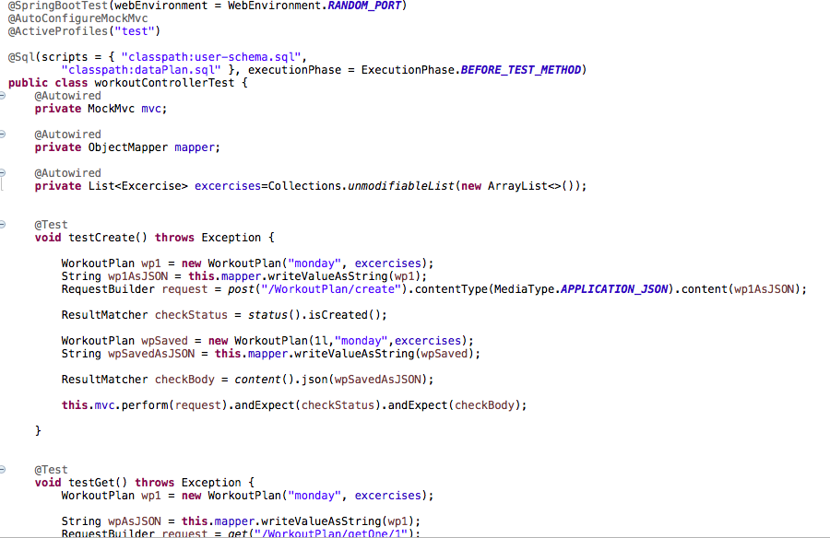
Created controller tests to determine if CRUD functionality of application is working as expected in frontend.

Slide 9
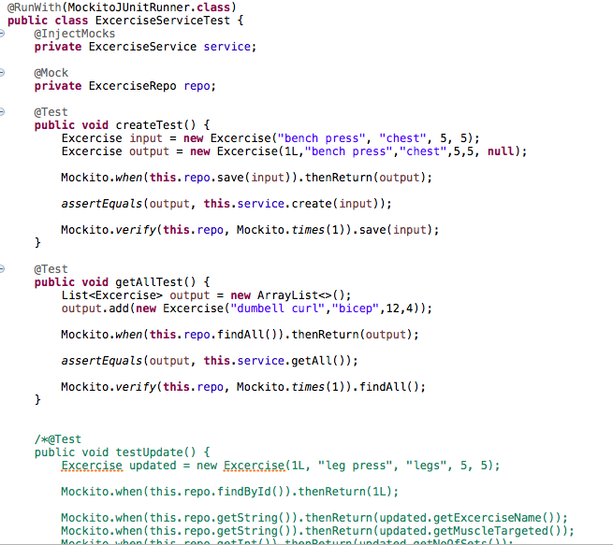
Attempted to create tests for services to see if Crud.

Slide 10
Creating Frontend to allow clients to access their workout planner.

Slide 11
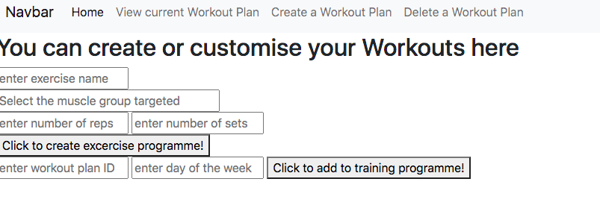
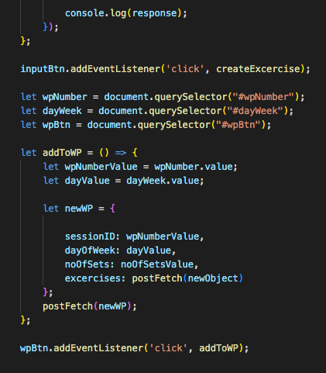
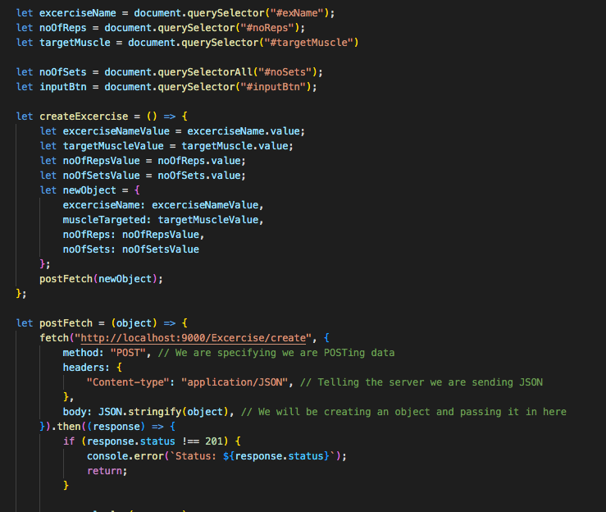
Created a webpage to handle create and update requests. Included relevant code in a JavaScript file.

Slide 12
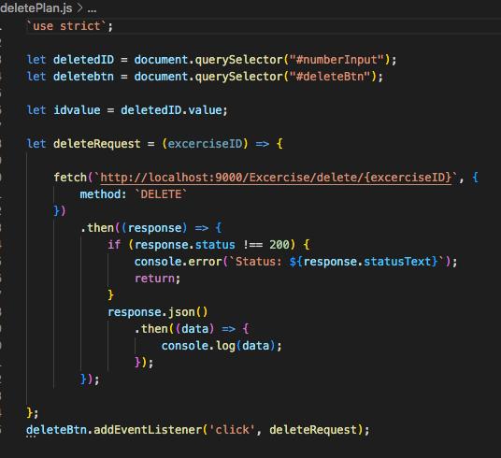
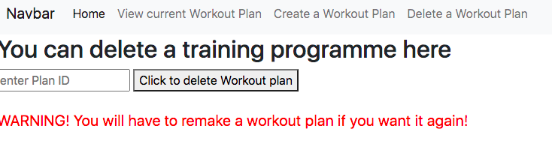
Created page to delete workout plans which are no longer required by user.

Slide 13

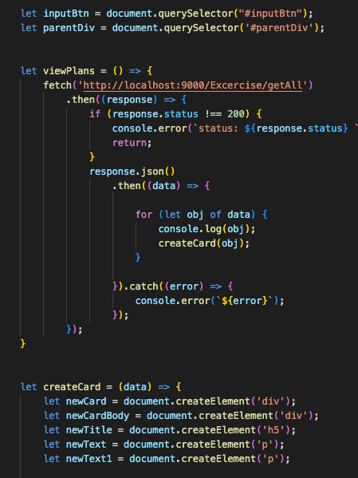
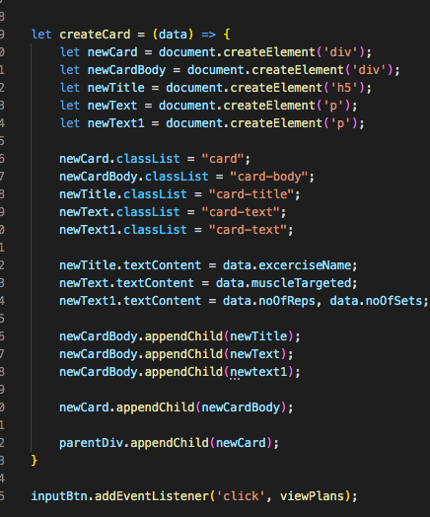
Created page to view (read) all current exercise plans. Used cards to display JSON objects in a structured way.

